Slide 1
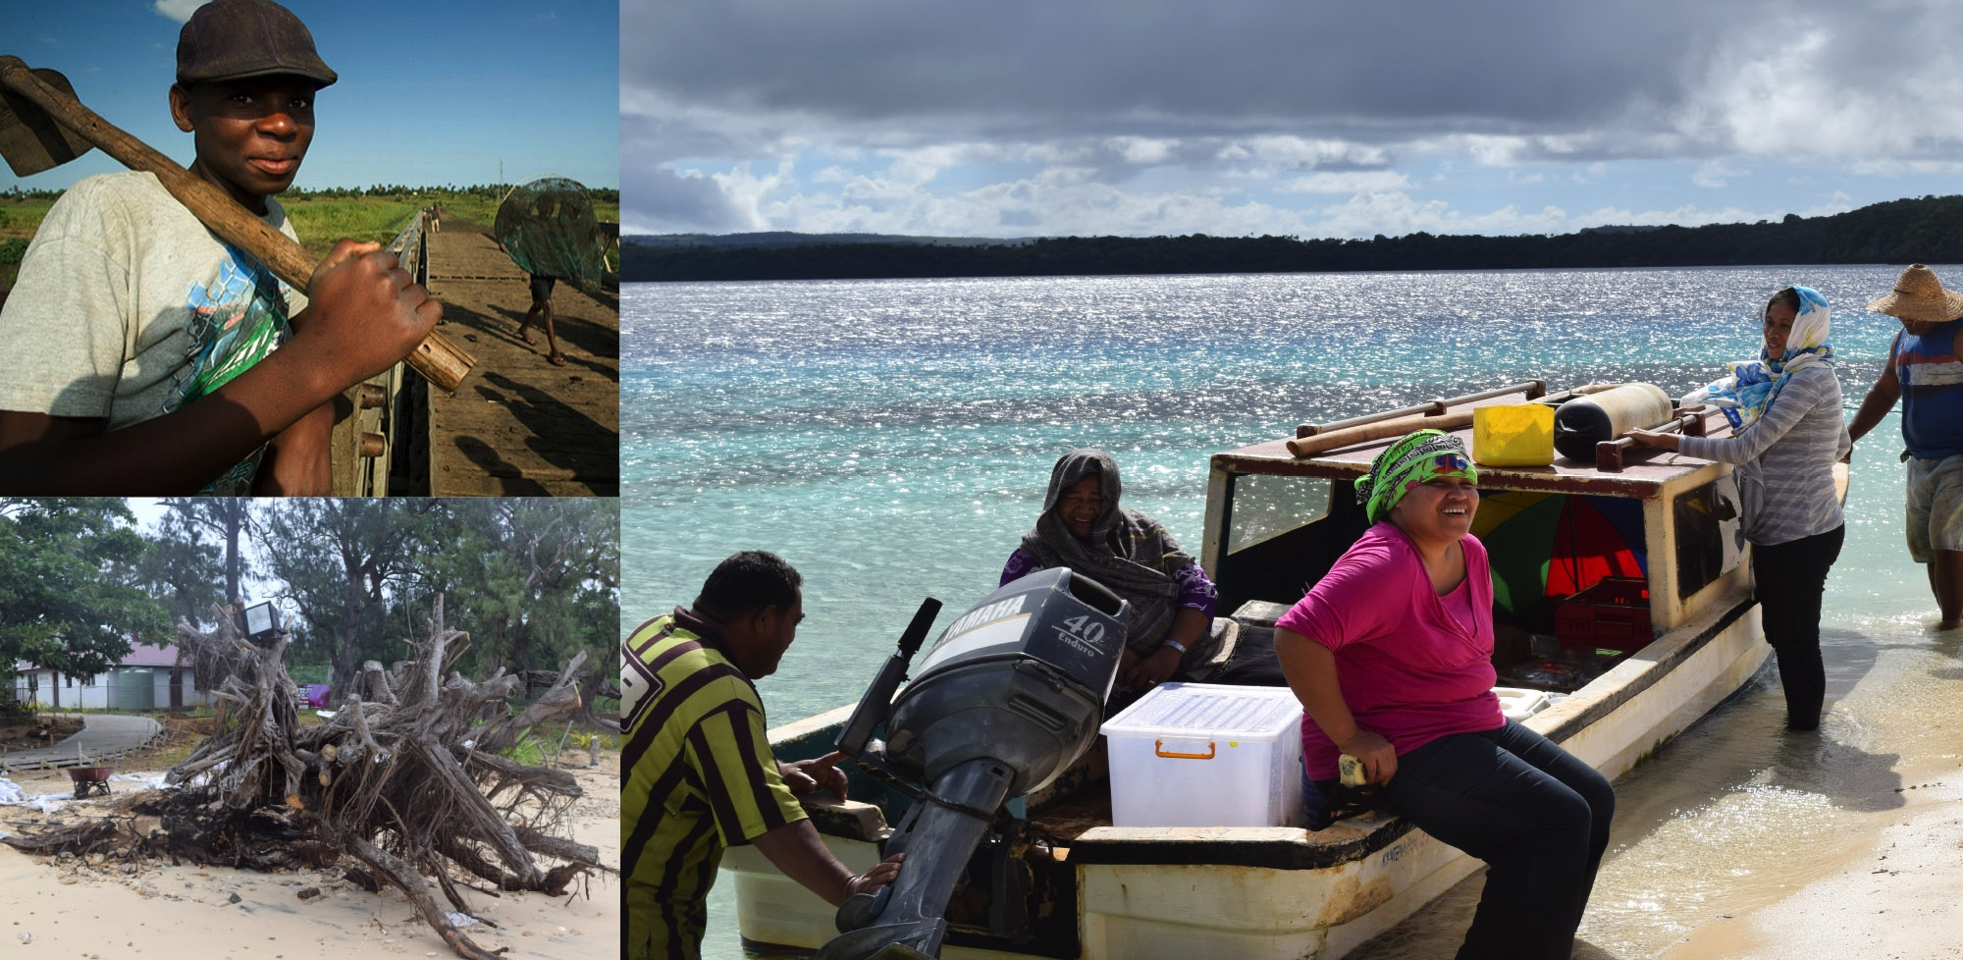
The Pilot Program for Climate Resilience (PPCR)

Slide 2
Outcomes from the Joint Meeting
Excerpts from the decision of the joint meeting on the strategic directions for the CIF:
Notes that the analysis took into account future opportunities and explored roles each CIF program could play based on its comparative advantage and value added
Notes the need to support the continuity of climate finance flows at scale in the near term through a diverse set of finance options
Recognizes the important role of the MDBs delivering climate finance
Highlights the importance of disbursing current CIF funds effectively
Agrees to continue monitoring the developments in the international climate finance architecture to inform the discussion on the sunset clause in Dec 2018 at the earliest, and take decision on this issue in June 2019, in particular as to if and when the Trustee should stop receiving new contributions for the CTF and/or the SCF.

Slide 3
Outcomes from the Joint Meeting
Excerpts from the decision of the joint meeting on the strategic directions for the CIF:
Agrees to enhance cooperation between CIF and other entities, particularly GCF through
Improved coordination at country level led by CIF Focal Points and GCF NDAs, including cooperation with MDBs as requested
Enhanced efforts by all CIF stakeholders to share lessons learned, including through CIF’s evaluation and learning special initiative
Explore joint training and learning for CIF and other multilateral climate finance mechanisms
Invites SCF Sub-Committees to consider the analysis presented the Strategic Directions paper on the specific context, lessons learned, and continued value proposition of these three programs (FIP, SREP and PPCR).

Slide 4
Lessons learned from PPCR
Coordination across multiple sectors supported with leadership from the highest levels of government
The expectation of linked and leveraged funds at scale was pivotal for country buy-in
Mandatory and documented stakeholder engagement built ownership and support for the SPCR design and implementation process.
Ability to evolve and be responsive to country capacities, political structures, and overall development regimes
PSSA faced many challenges due to structural mismatches with MDB private sector operations
Five core indicators expanded to track national progress towards resilient development in other country climate programs

Slide 5
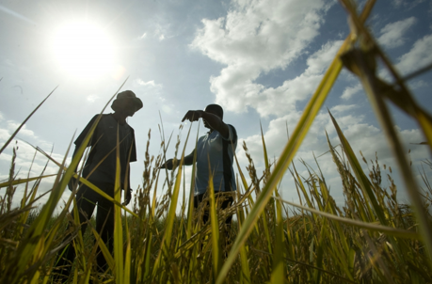
Value proposition for the PPCR
Tried and tested programmatic approach to mainstream resilience across sectors and monitor progress.
Ready made platform for translating INDCs into implementation plans and concrete investments.
Experience and risk appetite to support robust MDB pipeline of private sector resilience investments
Leverages unique capability of MDBs to climate-proof critical infrastructure.

Slide 6
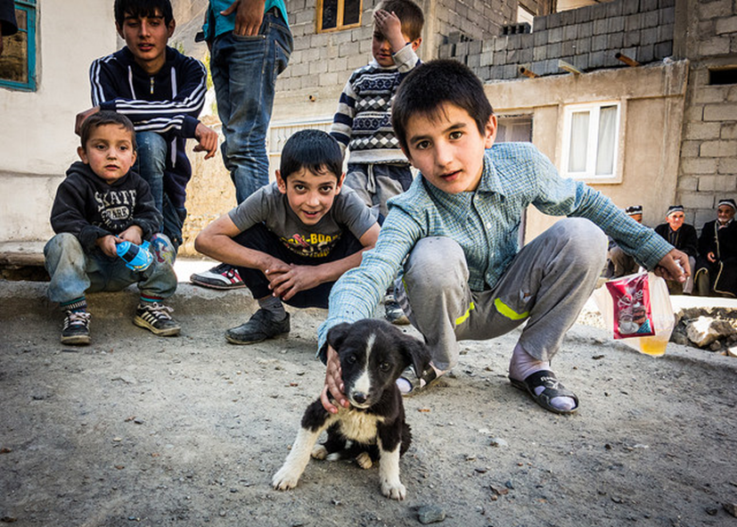
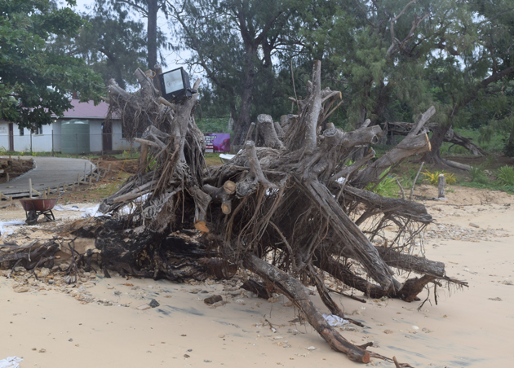
PPCR Future Scenario
Scenario 1: No new funds are provided
10 new pilot countries will continue to advance preparation of SPCRs.
Absence of core resources could undermine the design, commitment and delivery of the program; risk of fragmentation
Scenario 2: New funds are provided in the near to medium term
Extend implementation funding to some [all] of the 10 new countries
Launch new PPCR private sector window building on May 2015 enhanced framework
Launch strategic thematic program for health.

Slide 7
Thank You!
www.climateinvestmentfunds.org
@CIF_Action https://www.youtube.com/user/CIFaction https://www.flickr.com/photos/cifaction/sets

