Slide 1

CIF Summary of Key Activities and Decisions since last TFC/SC Meetings
Mafalda Duarte
June 15, 2016

Slide 2
Overview
1. CIF Portfolio update
2. Update of Key CIF Activities (December 2015 – June, 2016)
3. Update on implementation of decisions

Slide 3
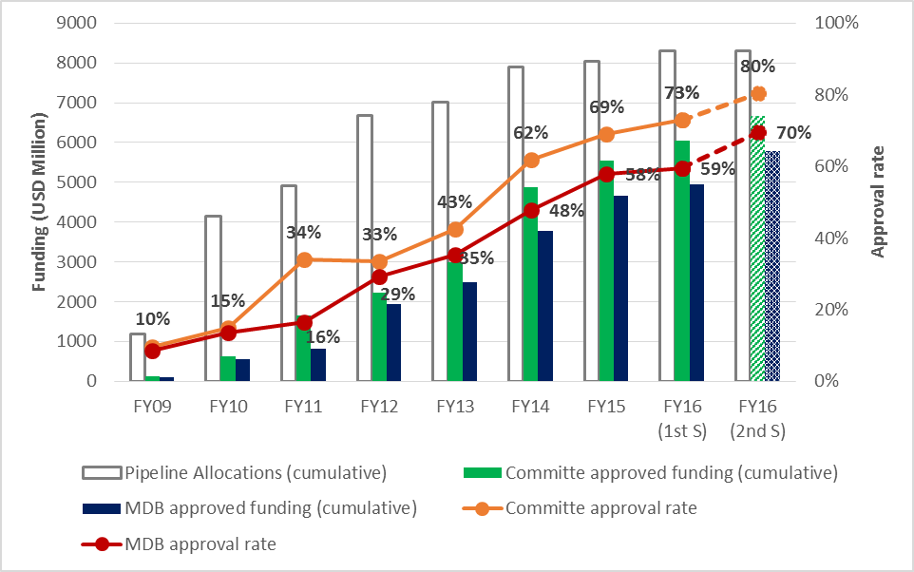
CIF Portfolio Update – Progress since last Committee Meeting
(1/2)
18 projects approved from the last meeting of the Trust Fund Committee and Sub-Committees in November, 2015 to May 31, 2016
  13 CTF projects representing USD 598.3 million
  5 SCF projects for USD 85.3 million
Cumulative approvals at the end of FY16 would be USD 6.7 billion.

Slide 4
CIF Portfolio Update (2/2)
3 Investment Plans submitted for endorsement in June, 2016
Over 20 scoping and joint missions since last TFC/SC meetings (40 in FY16)
Investment Plan Preparation Grants provided to 20 countries since last TFC/SC meetings (24 of 25 new FIP and PPCR countries in FY16)
Guidelines and terms of reference for expert review of Investment Plans updated

Slide 5
Highlights of Key CIF Activities - December, 2015 – June, 2016
CIF Strategic Analysis
  Brainstorming sessions with Civil society organizations, and think-tanks held in February, 2016
  Retreat with Committee members and Working Groups took place in March, 2016
  Technical workshop on CTF Financing Modalities held in April, 2016
  CIF co-sponsored the Climate transactions summit held in May, 2016

Slide 6
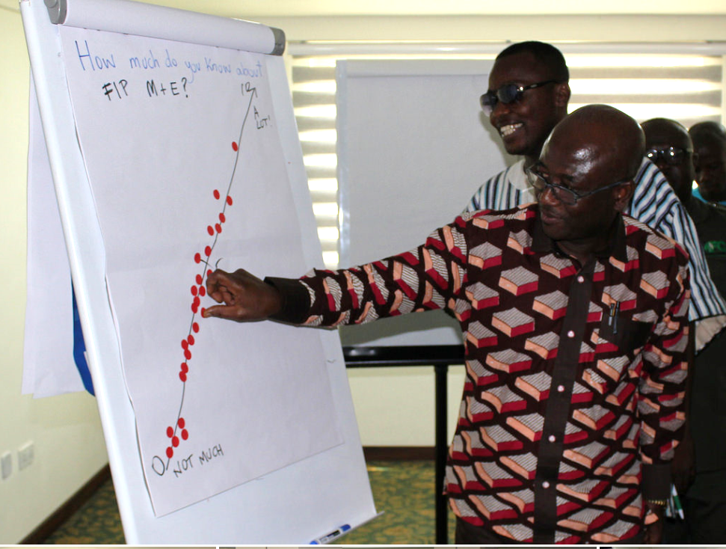
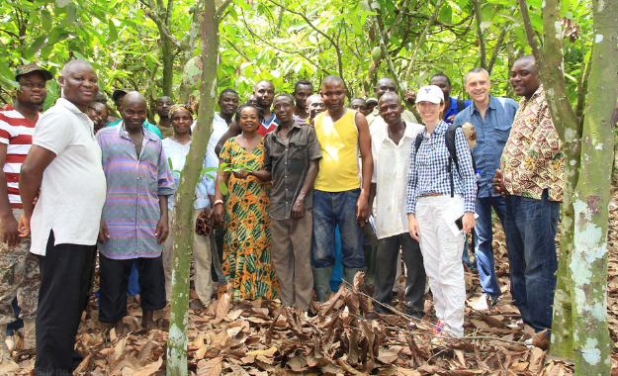
Highlights of Key CIF Activities - December, 2015 – June, 2016
Monitoring and Results (M&R)
FIP M&R Workshop held in Ghana (May, 2016), including field trips
PPCR M&R training held in Tonga, with participants from Samoa, Papua New Guinea, and regional NGOs
M&R support provided to the PPCR Caribbean Region; and to Lao PDR and Indonesia FIP programs
FIP GHG Harmonization workshop held in Washington, DC (April, 2016)

Slide 7
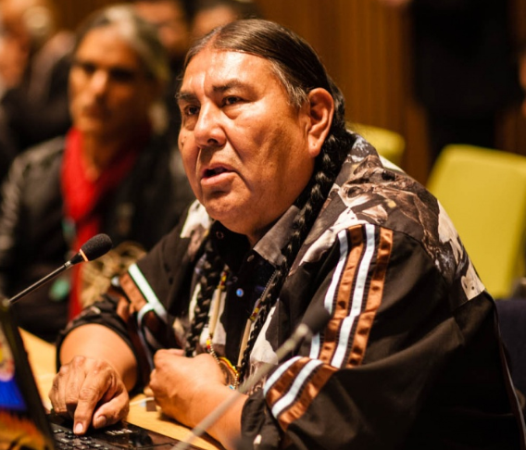
Highlights of Key CIF Activities - December, 2015 – June, 2016
Stakeholder Engagement
Regional Investment planning stakeholder workshops held in Hanoi, Nairobi, and Lima (April, 2016)
CIF participation in the annual United Nations Permanent Forum on Indigenous Issues (UNPFII) in New York (May, 2016)
Best practice guide on stakeholder mapping prepared
Notes:
Regional IP workshops were held to solicit views, thoughts, and perspectives on how to enhance indigenous peoples’ engagement in the CIF at all levels.
The UNPFII is the largest gathering of indigenous peoples. The CIF used this occasion to showcase mechanisms and approaches for enhancing the engagement of indigenous peoples and local communities in the CIF.

Slide 8
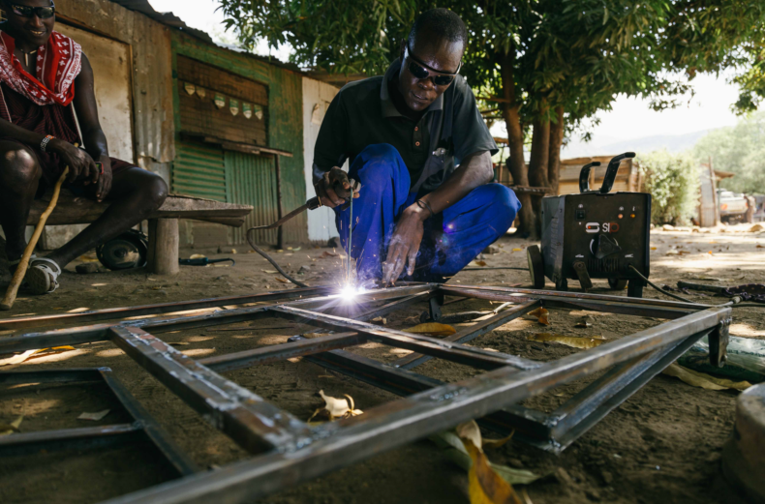
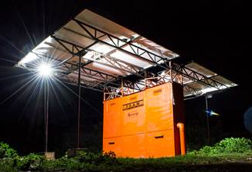
Highlights of Key CIF Activities - December, 2015 – June, 2016
Knowledge Management
Advisory Group on Evaluation and Learning
  Three meetings of the advisory group held in Washington, DC
  Business plan proposed for endorsement
Mini-Grids Workshop and Study Tour
  Study tour held in Kenya from May 23 – 27, 2016
  Learning events involving stakeholder groups from different mini grid programs in Africa and 13 African country representatives

Slide 9
Highlights of CIF Activities - December, 2015 – June, 2016
Learning Events
South-South learning
  South-South learning exchanges between old and new CIF countries to foster peer-to-peer learning, also reinforced in the FIP Pilot Countries Meeting
PPCR Learning Series
  4 learning events brought together researchers (universities, research institutes, and think tanks) to explore issues of migration, urban context, landscape approaches, and food security

Slide 10
Highlights of Key CIF Activities - December, 2015 – June, 2016
Targeting innovation through technology improvements
  CTF and SREP Results Data uploaded into the Online Open Source Data platform (SOCRATA)
  Enterprise Risk Dashboard (ERM) operationalized
  Comment tracking application developed
  Continued CIF website reform
  Project data uploaded and validated in the FIF collaborative platform

Slide 11





Update of Key Activities - December, 2015 – June, 2016
Strategic Staffing
Additional team members joined the CIFAU team:
Sandra Romboli
Senior Monitoring and
Evaluation Specialist
(May, 2016)
Joe Dickman
Senior Evaluation
Officer
(March, 2016)
Christopher Head
Private Sector Specialist
(March, 2016)
Angela Bekkers
Senior Communications
Officer
(January, 2016)
Ian Gray
Senior Program
Officer, FIP
(January, 2016)

Slide 12


Tracking adopted decisions and their implementation
Update on decisions taken at the Joint Meeting
Adopted Decisions | Reporting Methodology | Status | Comment/Update
Governance
Revised document on the code of conduct | Approval by mail | Completed | Approved in April, 2016
Proposed Guidelines and Procedure for selecting committee member seats for recipient countries | Approval by mail | Completed | December, 2015
Develop a system to track adopted decisions and their implementation | Notification by mail | Completed | Circulated for comments. Online page to be finalized after comments receipt
Continue to collaborate with the Trustee to develop a Web-based, secure collaboration platform for approving decisions | Committee meeting presentation | In Progress | Comment tracking application completed. Approval by mail platform to be completed by November, 2016
Document on the roles and responsibilities of the co-chairs, committee members and observes | Notification by mail | Completed | Approved in May, 2016
Risk and Resources
Finalize Non-Disclosure Agreements | Notification by mail | In Progress | 1 NDA with AfDB remains outstanding – completion in June, 2016
Proposal on Future of Partnership Forum | Approval by mail | In Progress | Postponed to align with the Evaluation for Learning Initiative
Report on progress made in operationalizing the ERM Dashboard | Notification by mail | Completed | Other elements pending completion
Prepare CIF disbursement projections | Committee meeting presentation | Completed | Disbursement Report provided as information document
Evaluation and Learning
Hire a Senior Evaluation and Learning Specialist to lead the implementation of the actions proposed for the generation of knowledge from evaluation for learning | Notification by mail | Completed | Senior Evaluation and Learning Specialist joined in March, 2016

Slide 13
Tracking adopted decisions and their implementation
Update on decisions taken at the CTF TFC and SCF Sub-Committees
Program | Adopted Decisions | Reporting Methodology | Status | Comment/Update
CTF | Report on pipeline management process and cancellation policy | Approval by mail | In progress | Circulated for approval by mail on June 3, 2016
CTF | Explore currency risk mitigation strategies associated with unencashed promissory notes | For update to the Committee | Complete | Updated in the SAR (addendum)
CTF | Continue analysis on the CTF Financing Modalities Paper to further explore the detailed financial and risk management modalities, including legal, institutional and governance changes required to implement any proposed options. | For Committee meeting discussion | Completed | June, 2016
FIP | MDB and CIF AU to work towards harmonizing GHG emission baselines and targets | For update to the Committee | In progress | Workshop held in April, 2016. Completion: November, 2016
FIP | Further explore synergies and enhance cooperation, where applicable, with other REDD+ financing mechanisms, such as the FCPF | For update to the Committee | In progress | Semi-annual update provided in SAR
FIP | Provide further information on factors contributing to the delay in the implementation of IPs and projects (in the SAR) | For update to the Committee | In progress | Semi-annual update provided in SAR
FIP | Provide procedural guidelines to the new FIP countries and MDBs on exploiting operational efficiencies and exploring synergies between SCF programs in developing and implementing IPs | For update to the Committee | Completed | Update provided in SAR
FIP | Provide support to FIP countries in pursuing stakeholder engagement for monitoring and reporting | For update to the Committee | In progress | Semi-annual update provided in SAR
FIP | Include projections on future disbursements in the SAR | For update to the Committee | Completed | Semi-annual update provided in SAR

Slide 14




Mafalda Duarte
Mduarte@worldbank.org
(202) 473 - 4678
www.climateinvestmentfunds.org
@CIF_Action
https://www.youtube.com/user/CIFaction
https://www.flickr.com/photos/cifaction/sets

