Slide 1
CIF Evaluation and Learning Special Initiative: Business Plan
^{DATE June 15, 2016}
^{PLACE Oaxaca, Mexico}
^{VENUE Joint Meeting of the} ^{CTF and} ^{SCF Trust Fund Committees}

Slide 2
INTRODUCTION
Introductory video message by Advisory Group member and external expert, Rob Van den Berg:
Dropbox - Introduction Rob van den Berg.wmv

Slide 3
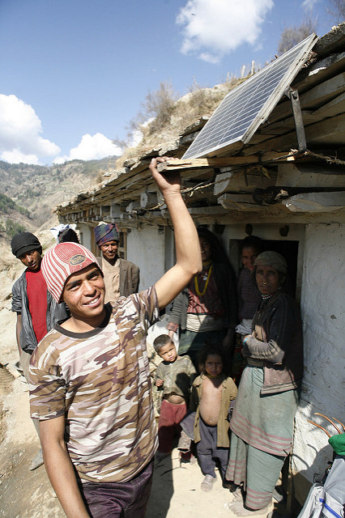
WHY EVALUATION AND LEARNING?
Purpose:
To capture evidence and lessons on an ongoing basis so that they can inform ongoing CIF activities within an actionable time horizon, where adjustments are still possible; and,
To identify valuable evidence and lessons learned to inform current and future climate finance investments.

Slide 4
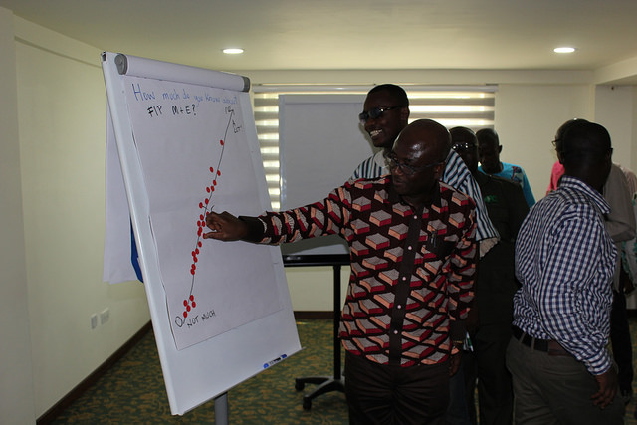
Driven by users, Grounded in best practice
Context
How do people and organizations learn?
What works in evaluation for learning?
What is unique about the CIF?
Key Principles
User-centric (43 initial consultations of CIF stakeholders)
Relevant and timely to inform decisions and strategies
Participatory and learning-oriented
Use of both innovative and proven approaches

Slide 5
A focused learning agenda
Four priority learning themes:
Transformational change
Private sector investment
Local stakeholder engagement and benefit
CIF design and approach
Cross-cutting: Gender and inclusivity dimensions

Slide 6
IMPLEMENTATION
Highly collaborative
Criteria to guide selection
Mix of ‘quick wins’ and longer-term partnerships
Range of approaches
Advisory Group

Slide 7
Advisory group and country perspective
Comments by Gustavo Luedemann
Advisory Group Member, IPEA, Brazil

Slide 8
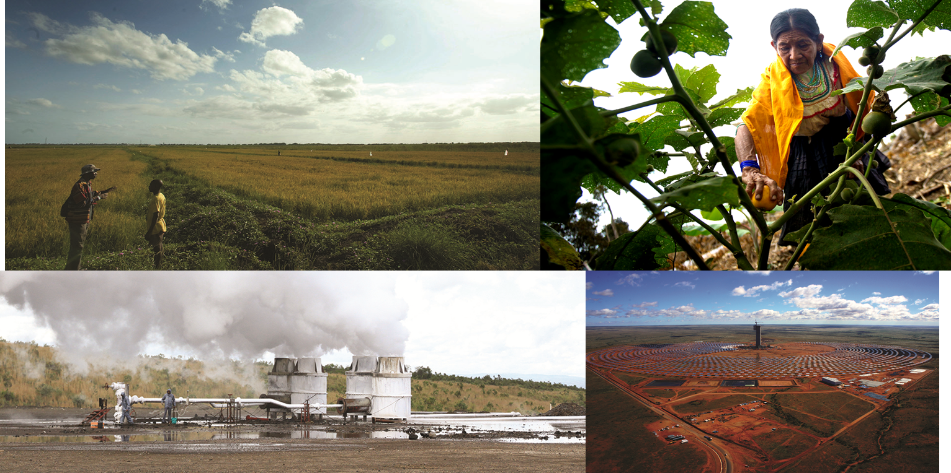
thank you!
Questions and discussion

