Slide 1
Future Directions of the Clean Technology Fund
June, 2019

Slide 2
Background
inform the discussions on the sunset clauses of CTF and SCF in December 2018, and take a decision on this issue in June 2019.
the Joint Meeting acknowledged the significant contribution of the CIF business model in driving scaled investments into clean energy, climate resilience and sustainable forest management over the past ten years.
CIF AU was requested to provide the TFCs with the key considerations regarding the future of the CIF, including the sunset clause of CTF and SCF, to better inform the TFCs regarding options for future operations of the CIF
June 2016
Jan 2019
Jun 2019
Notes:
JUNE 2016:
At its meeting in June 2016 the Joint Meeting of the CTF and SCF TFCs decided to continue to monitor the developments in the international climate finance architecture to inform the discussions on the sunset clauses of CTF and SCF in December 2018, at the earliest, and take a decision on this issue in June 2019.
Jan 2019:
Members emphasized the need to build on CIF’s important legacy of success and to draw lessons from its proven business model as the climate finance architecture continues to develop.
The majority of members took the opportunity to note that triggering of the CTF and SCF sunset clauses in June 2019 would be premature given the track record of the CIF, the urgency of climate action and the continued need for effective delivery channels for climate finance
JUN 2019:
In preparation for the June 2019 discussion on the future of the CIF, the CIF AU was requested to provide the TFCs with the key considerations regarding the future of the CIF, including the sunset clause of CTF and SCF, to better inform the TFCs regarding options for future operations of the CIF.
Given that decisions pertaining to SCF are the sole responsibility of the SCF TFC, a summary of the relevant information vis-à-vis SCF is presented below

Slide 3
Sunset Clause
53. Recognizing that the establishment of the CTF is not to prejudice the on-going UNFCCC deliberations regarding the future of the climate change regime, including its financial architecture, the CTF will take necessary steps to conclude its operations once a new financial architecture is effective. The Trustee will not enter into any new agreement with contributors for contributions to the CTF once the agreement providing for the new financial architecture is effective. The CTF Trust Fund Committee will decide the date on which it will cease making allocations from the outstanding balance of the CTF.
Notes:
We know what the document says… but…

Slide 4
Sunset Clause
53. Recognizing that the establishment of the CTF is not to prejudice the on-going UNFCCC deliberations regarding the future of the climate change regime, including its financial architecture, the CTF will take necessary steps to conclude its operations once a new financial architecture is effective. The Trustee will not enter into any new agreement with contributors for contributions to the CTF once the agreement providing for the new financial architecture is effective. The CTF Trust Fund Committee will decide the date on which it will cease making allocations from the outstanding balance of the CTF.
Notes:
53. Recognizing that the establishment of the CTF is not to prejudice the on-going UNFCCC deliberations regarding the future of the climate change regime, including its financial architecture, the CTF will take necessary steps to conclude its operations once a new financial architecture is effective. The Trustee will not enter into any new agreement with contributors for contributions to the CTF once the agreement providing for the new financial architecture is effective. The CTF Trust Fund Committee will decide the date on which it will cease making allocations from the outstanding balance of the CTF
54. The Trustee will, in accordance with the Contribution Agreements, continue to administer the Trust Fund after the cessation of allocations by the CTF Trust Fund Committee until such date specified in the Contribution Agreements, in order to receive in the Trust Fund scheduled reflows of funds from outstanding CTF financing. Following the date so specified in the Contribution Agreements, the Trustee, on behalf of each contributor, will endeavor to transfer the contributor’s share to another fund, which has a similar objective as the CTF as determined by the CTF Trust Fund Committee, or otherwise transfer or return the share to such other place, as agreed between the contributor and the Trustee under the Contribution Agreement.
55. Notwithstanding paragraph 53 above, if the outcome of the UNFCCC negotiations so indicates, the CTF Trust Fund Committee, with the consent of the Trustee, may take necessary steps to continue the operations of the CTF, with modifications as appropriate
KEY POINTS:
Per CTF the Governance Framework Document, as a first step to conclude CTF’s operations “once a new financial architecture is effective”, the Trustee is expected to stop entering into any new agreements with contributors for contributions to the CTF “once the agreement providing for the new financial architecture is effective”
The terms “financial architecture” and “effective” are neither defined in the context of the UNFCCC nor in any other subsidiary documents. Therefore, the CTF TFC would need to deliberate and decide when the climate “financial architecture” can be considered to be “effective” in order to determine when the CTF should take necessary steps to conclude its operation, or when the Trustee should no longer enter into any new agreement with contributors for contributions to the CTF.
Regarding reflows, the Governance Framework document provides that the Trustee will continue to manage the CTF trust fund in order to receive reflows until the date specified in the contribution agreements/arrangements (“Contribution Agreements”) between the contributor and the Trustee (“Final Transfer Date”). After that date, the Trustee, on behalf of each grant and capital contributor, will endeavor to transfer the contributor’s share to another fund which has a similar objective as the CTF as determined by the CTF Trust Fund Committee, or otherwise transfer or return the share to such other place, as agreed between the contributor and the Trustee under the Contribution Agreement.
Payments to CTF loan contributors are to be made in accordance with the schedule agreed in the loan agreements/arrangements. In accordance with the provisions of the Contribution Agreements for grant and capital contributors to the CTF, these contributors may also make arrangements for transfer or return of their shares upon written request any time before the Final Transfer Date.
However, grant or capital contributors to the CTF may not withdraw any part of their shares, unless the Trustee is satisfied that there will remain sufficient assets in the CTF trust fund to meet all outstanding obligations under the CTF loan contributions.

Slide 5
Which options?

Slide 6
Sunset Clause Options
Trigger
Postpone
Remove
Notes:
Based on the CTF Governance Framework document, the CTF Trust Fund Committee can consider the following three options with regards to the CTF sunset clause:

Slide 7
Sunset Clause Options
Trigger
Postpone
Remove
Notes:
Trigger the Sunset Clause: In accordance with Section 53 of the CTF Governance Framework Document, the CTF Trust Fund Committee could decide to trigger the sunset clause by noting that the climate financial architecture is considered “effective,” and that CTF should take necessary steps to conclude its operations, and decide on a date when the Trustee should no longer enter into any new contribution agreements for CTF.

Slide 8
Sunset Clause Options
Trigger
Postpone
Remove
Notes:
Postpone the Sunset Clause Decision: The CTF Trust Fund Committee could decide to postpone the sunset clause decision until a more suitable time.

Slide 9
Sunset Clause Options
Trigger
Postpone
Remove
Notes:
Remove the Sunset Clause from the CTF Governance Framework Document: It is the prerogative of the CTF Trust Fund Committee to decide on changes to its Governance Framework Document and its articles therein. If the CTF Trust Fund Committee decides to remove the sunset clause from the CTF Governance Framework Document, this would not impact its prerogative to decide at any point in time that new contributions should cease to be made to the CTF.

Slide 10
Urgency of Climate Action in the Near-Term
IPCC Special Report - Global Warming of 1.5 ºC
The climate consequences of a 2 C world are far greater than that of 1.5 C, especially for the poor and the vulnerable.
Limiting warming to 1.5 C will require a major (unprecedented) economic transformation, is barely feasible now, and every year we delay the window of feasibility halves.
From The Wall Street Journal
PG&E: The First Climate-Change Bankruptcy, Probably Not the Last
- The fast fall of PG&E after California’s wildfires is a jolt for companies considering the uncertain risks of a warming planet
- California’s largest utility was overwhelmed by rapid climatic changes…
January 18, 2019
While the challenge is daunting, the window of opportunity is not yet closed.
We have 11 years to enact the unprecedented, “rapid and far-reaching” transitions in land, energy, industry, buildings, transport, and cities needed to overcome the existential threat of climate change.
The world is expected to invest some $90 trillion on infrastructure by 2030. Much of this investment will be programmed in the next 2 to 3 years.
10

Slide 11
CIF’s business model has proven to help accelerate investments for rapid and systemic climate action
CIF’s comparative advantage resides in the unique features of its business model
5 core elements
Country-led programmatic participatory approach
Large-scale coherent intervention packages
Multi-MDB coordination
Scaled-up predictable & flexible concessional resources
Consideration of social inclusion
at the outset
Source: ITAD et al., (2019).
Notes:
The implementation of effective and efficient 1.5°C-consistent responses calls for a programmatic approach, multi-stakeholder partnerships, coordinated interventions and flexible concessional capital at scale -> CIF’s business model
Independent studies found that CIF’s comparative advantage resides in the key features of its business model, unique among climate funds
The 5 key elements of CIF’s business model that have helped it drive transformational change are:
Country-led programmatic participatory approach, that sets the stage for multi-sector transformation, supported by stakeholder dialogue, engagement of influential champions, and alignment with national programs and ambitions.
Explicit consideration of transformational change at the design phase.
Delivery of financing through multiple coordinated MDBs working together, sometimes for the first time, to support the implementation of coherent large-scale investment packages for cross-sectoral interventions responding to countries’ priorities and objectives
Large-scale coherent investment packages helping move markets and drive policy reform
Scaled-up, predictable, and flexible envelope of concessional resources, making it possible to develop influential, often first-of-a-kind projects to address barriers and accelerate progress
The scale, concessionality, and predictability of CIF resources has helped to engage MDBs, governments, and private sector actors. It has mobilized support, influencing the type of projects CIF can support.
Consideration of social inclusion at the outset empowers women, indigenous peoples and local communities

Slide 12
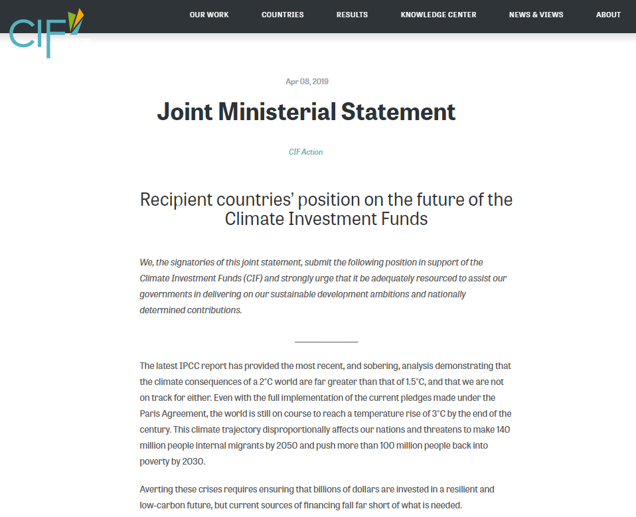
Recipient countries recognize the vital role CIF has played, and are urging for continued CIF support
Ministers from the following 47 CIF recipient countries signed a Joint Ministerial Statement “strongly urging that the CIF be adequately resourced in light of the vital role it has played, and continues to play, in helping secure the safety and sustained prosperity of our peoples in a climate changing world”
47 CIF recipient countries representing a combined population of over 3 billion people
Armenia
Bangladesh
Benin
Bhutan
Bolivia
Brazil
Burkina Faso
Cambodia
Cameroon
Colombia
Cote d'Ivoire
DRC
Egypt
Ghana
Guyana
Honduras
India
Jamaica
Kenya
Kiribati
Kyrgyz Republic
Lao PDR
Liberia
Madagascar
Malawi
Mali
Mexico
Mongolia
Mozambique
Niger
Nigeria
Papua New Guinea
Philippines
Samoa
Sierra Leone
Solomon Islands
South Africa
St. Lucia
Tajikistan
Tonga
Tunisia
Turkey
Uganda
Ukraine
Vanuatu
Vietnam
Zambia
→G24 countries issued a Communique on 11 April 2019 echoing this call (it is the 4th such statement issued by the Group since 2016)
12
www.climateinvestmentfunds.org/news/joint-ministerial-statement
Notes:
Ministers from 47 CIF recipient countries signed a Joint Ministerial Statement urging the international community to adequately resource the CIF so as to secure its continue support in delivering on their sustainable development ambitions and nationally determined contributions.

Slide 13
Short-Term Options to maximize the use of CTF | REFLOWS
Using CTF reflows to support new CTF investments
Leverage CTF reflows via CTF 2.0
Notes:
In 2014-2015, the Sub-Committees of the three SCF programs invited an additional 25 countries into the SCF
Countries worked with MDBs and other key stakeholders to develop strong, country-led Investment Plans
As no new large funding envelope was made available for the investment components of these plans, countries and MDBs were urged to seek funding from other sources, in particular the Green Climate Fund
Current funding gaps for SCF programs
The FIP unfunded pipeline has a combined funding request of USD 215 million to support 20 projects that were identified within the FIP Investment Plans for Tunisia, Bangladesh, Zambia, Cambodia, Cameroon, Rwanda and Uganda.
The PPCR funding gap for projects identified under the endorsed SPCRs for Bhutan, Ethiopia, Gambia, Honduras, Kyrgyz, Madagascar, Malawi, Philippines, Rwanda and Uganda, amounts to a combined funding request of USD 1.6 billion
The SREP funding gap, considering the current reserve pipeline, is approximately USD 70 million for projects in Zambia, Cambodia, Lesotho, Ghana, Uganda, Nicaragua and Madagascar.
Limited opportunities for GCF to support unfunded SCF projects
Differences in the CIF and GCF business models has made it difficult for MDBs to submit SCF unfunded projects to GCF
Consequently, the World Bank is the only MDB seeking funding from GCF for four PPCR projects, one in Uganda, one in Madagascar, and two in Rwanda for a total funding request of USD 144 million.
SCF countries continue to express interest in moving the projects forward, though there are currently few funding alternatives available for them.

Slide 14
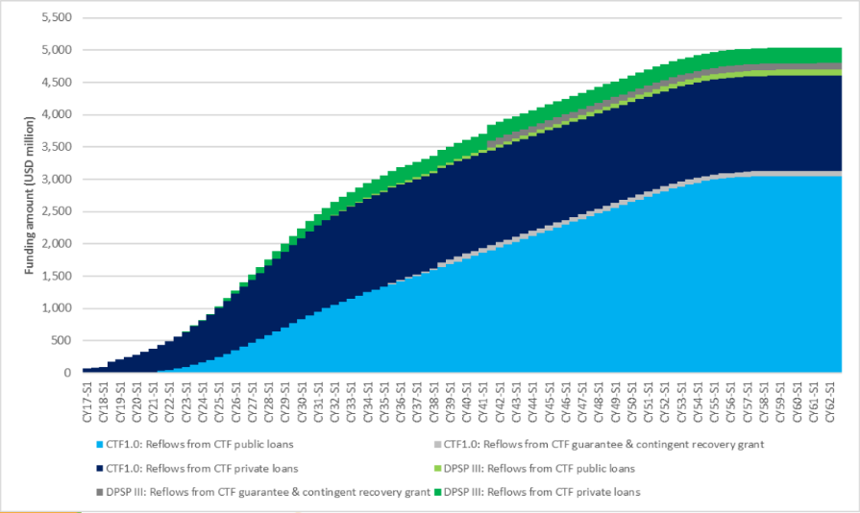
Short-Term Options to maximize the use of CTF | REFLOWS
1. Using CTF reflows to support new CTF investments
Notes:
Principal repayments on CTF loans commenced in 2017 (USD 80 million) and will continue to accumulate for another 40+ years. This initial flow of repayments is mostly from private sector investments; 65% of the CTF is very long-tenored public sector loans.
As reflows grow slowly over time, the net available proceeds will be on average USD 135 million per year over the next decade. These funds could be used to support new CTF programming.
In order to do so, a decision is required by CTF contributors to allow for the use of reflows to support new programming.

Slide 15
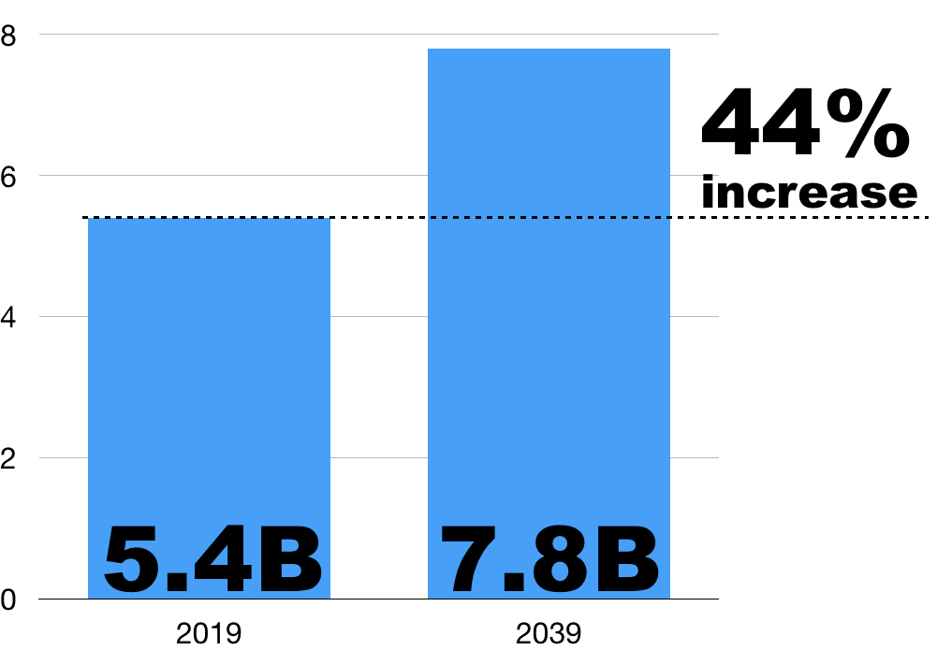
Short-Term Options to maximize the use of CTF | REFLOWS
2. Leveraging CTF reflows via CTF 2.0
Notes:
As previously presented to the CTF Trust Fund Committee, most recently in January 2019, the initial contributions from CTF could be leveraged to continue providing low-cost financing for low carbon investments through a proposed investment vehicle called CTF 2.0.
Assuming all CTF donors remain in the CTF and no new contributions are made, the value of CTF’s outstanding loan assets plus other resources could be leveraged through capital markets to grow from a current USD5.4 billion to USD7.8 billion in 20 years (a 44% increase).
In order to maintain the existing level of concessionality of the CTF and maximize CTF 2.0’s ability to drive the level of transformation being observed under CTF at present new contributions from donors would be needed.
The CTF 2.0 structure would also require new legal, operational and governance arrangements to be agreed and established between all relevant parties. Pending agreement among contributors on the use of reflows, internal due diligence by IBRD as Trustee and the MDBs would need to be completed to ensure that all conditions are in place for CTF 2.0 to move forward.
Keeping the CTF’s assets locked up, earning only simple interest on cash balances, for more than a decade – until 2032 – represents a significant missed opportunity at a time when urgency, ambition, and scale are critical.

Slide 16
Short-Term Options to maximize the use of CTF | NEW CONTRIBUTIONS
New CTF programming through the CTF Dedicated Private Sector Programs (DPSP)
Delivery of the new program proposals included in the Strategic Directions for the CIF policy paper
Notes:
The delivery of the new program proposals included in the Strategic Directions for the CIF policy paper - (June 2019), presented to the Joint Meeting of the CTF and SCF Trust Fund Committees. These proposals seek to harness the unique strengths of CIF’s model to accelerate far-reaching transitions –
Global Program for Large-Scale Integration of Renewable Energy
Global Program for Climate-Smart Urbanization
Global Program for Accelerating the Low-carbon Transition in Industry

Slide 17
Short-Term Options to maximize the use of CTF | NEW CONTRIBUTIONS
2. New program proposals
Global Program for Large-Scale Integration of Renewable Energy
Global Program for Climate-Smart Urbanization
Global Program for Accelerating the Low-carbon Transition in Industry
Notes:
The delivery of the new program proposals included in the Strategic Directions for the CIF policy paper - (June 2019), presented to the Joint Meeting of the CTF and SCF Trust Fund Committees. These proposals seek to harness the unique strengths of CIF’s model to accelerate far-reaching transitions –
Global Program for Large-Scale Integration of Renewable Energy
Global Program for Climate-Smart Urbanization
Global Program for Accelerating the Low-carbon Transition in Industry

Slide 18
Thank You!
Mafalda Duarte
Mduarte@worldbank.org
(202) 473 - 4678
www.climateinvestmentfunds.org
@CIF_Action https://www.youtube.com/user/CIFaction https://www.flickr.com/photos/cifaction/sets

