Slide 1
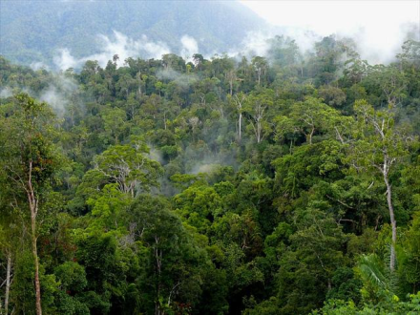
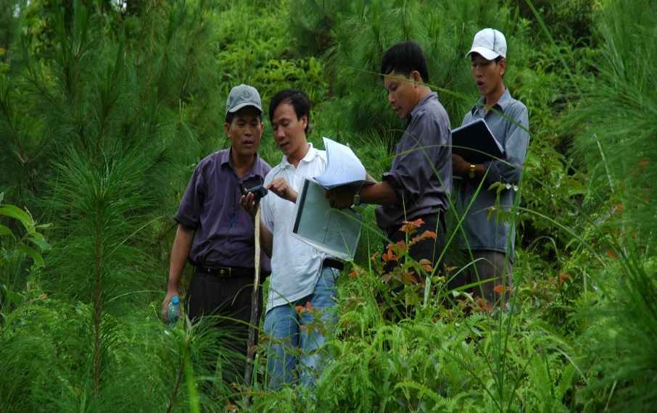
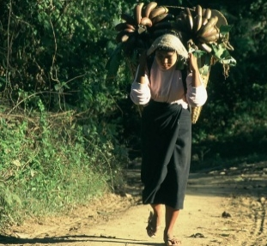
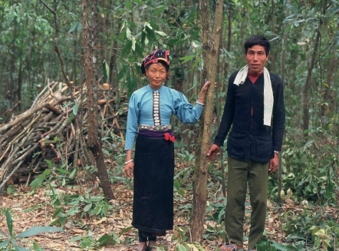
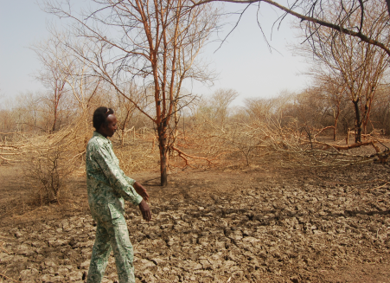
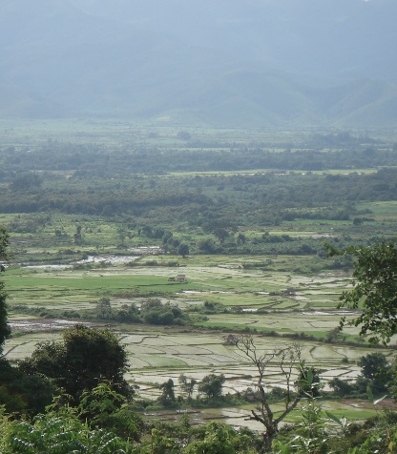
FIP Semi-Annual Report
^{DATE June 16, 2016}
^{PLACE Oaxaca, Mexico}
VENUE Meeting of the FIP Sub-Committee

Slide 2
Strategic Issues
Global interest in forests with Paris Agreement, INDCs, SDGs
Challenge of how these can be implemented and role for FIP
New chapter for FIP: working with 8 original, 6 new and 9 additional FIP countries
Resource availability within FIP
Portfolio trends and disbursements
DGM progress

Slide 3
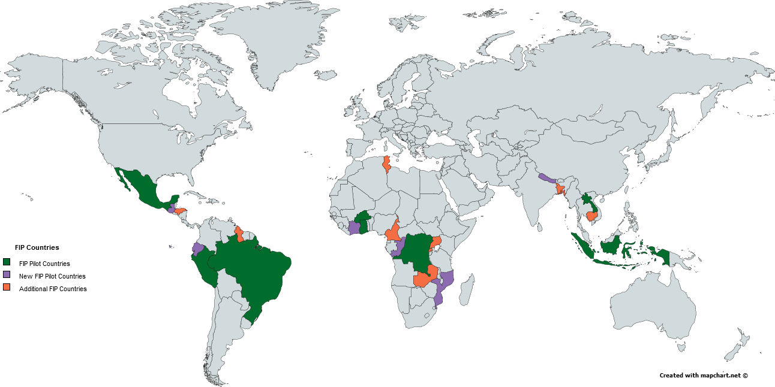
FIP Pilot Countries
FIP at important point in its development
8 Pilot Countries IPs approved, under implementation
6 New Pilot Countries, IPs under development
9 Additional Countries, IPs under development (without investment funds)
Evolving architecture with Paris Agreement, INDCs and SDGs, and GCF

Slide 4
New and Additional Country Updates
Country | MDBs | Dialogue | Scoping Mission | Joint Mission | Notes
Congo Rep | AfDB, IBRD |  | 
Cote d’Ivoire | AfDB, IBRD |  |  |  | IP submitted for SC
Ecuador | IDB, IBRD, IFC | 
Guatemala | IDB | 
Mozambique | AfDB, IBRD, IFC |  |  |  | IP submitted for SC
Nepal | IBRD | 
Bangladesh | ADB, IBRD, IFC | 
Cambodia | ADB |  | 
Cameroon | AfDB, IBRD |  | 
Guyana |  | 
Honduras | IDB, IBRD, IFC |  |  |  | Joint PPCR/FIP scoping mission
Rwanda | AfDB, IBRD |  |  |  | Joint PPCR/FIP scoping mission
Tunisia | AfDB, IBRD, EBRD |  | 
Uganda | AfDB, IBRD |  |  |  | Joint PPCR/FIP scoping mission
Zambia | AfDB, IBRD, IFC |  | 

Slide 5
Resources Availablity
Addendum to update resource availability schedule and project approvals as of May 31, 2016, extract:
 | USD Million
Unrestricted Fund Balance | 343.7
Total Anticipated Commitments | 393.0
Available Resources (Balance – Commitments) | (49.3)
Potential Future Resources | 56.9
Potential Available Resources | 7.6

Slide 6
FIP Overview
FIP Portfolio (USD million)
 | Endorsed Indicative Allocation |  |  |  | Approved funding |  | Disbursement
 | TOTAL | IP | DGM | PSSA | Committee | MBD
FIP Funding (in USD M) | 555.2 | 455.0 | 80.0 | 20.3 | 325.1 | 291.8 | 36.1
Number of projects | 47 | 27 | 16 | 4 | 22 | 18 | 14
At December 31, 2015
USD 555.2 has been endorsed by the FIP Sub-Committee
8 endorsed Investment Plans
DGM first and second tranches
Private Sector Set Aside

Slide 7
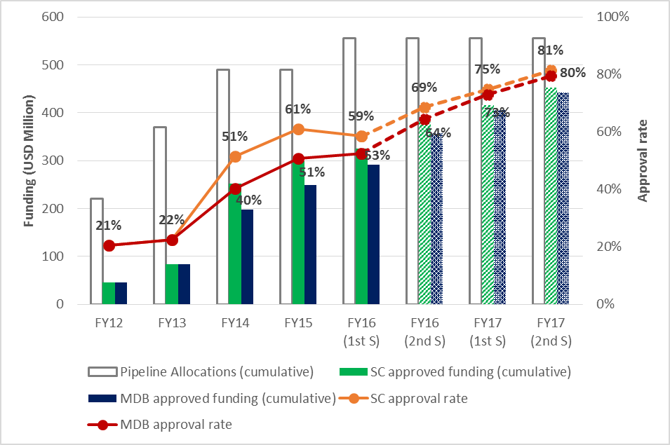
Trends in Funding Approvals by FY
Cumulative funding approvals have risen steadily
By December 31, 2015 59% of currently endorsed funding was approved by the Sub-Committee and 53% approved by MDBs
12 projects projected to be submitted for Sub-Committee approval by end of FY17
Pipeline tracking

Slide 8
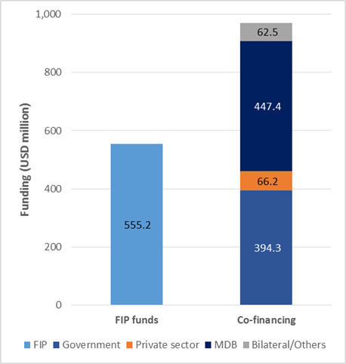
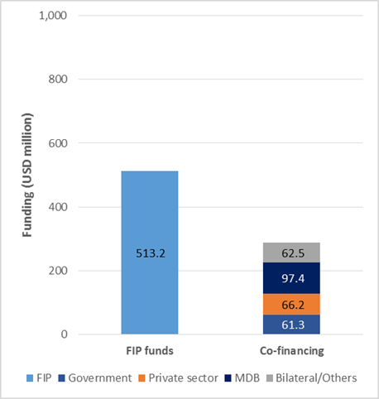
Co-financing
Indicative FIP Co-Financing Breakdown by Source on Approved Projects a) with the Mexico project; and b) without the Mexico project
Projected co-financing for endorsed portfolio USD 970.5 million (ratio of 1:1.75)
Heavily influenced by Mexico FCCP with co-finance of USD 683 million
Portfolio co-finance without Mexico FCCP is USD 287.4 million (ratio of 1:0.56)
Main sources MDBs and Governments

Slide 9
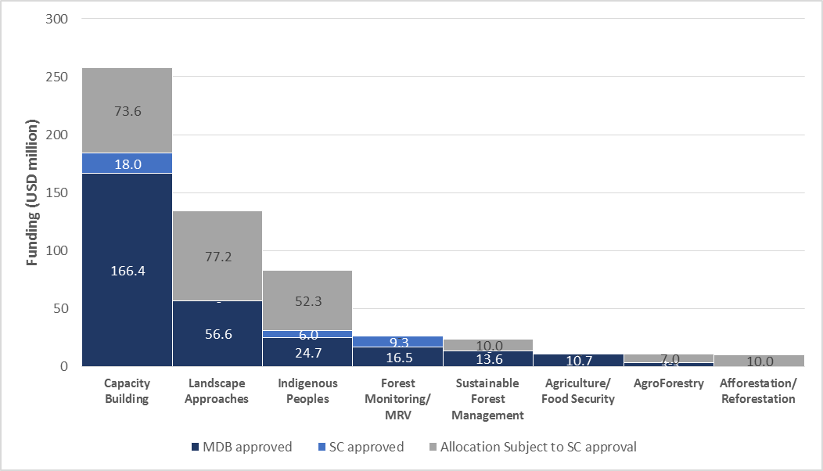
Portfolio by Thematic Focus
46% of FIP funds focus on capacity building activities
Reflects long term position of sector in many countries
Foundational elements essential for lasting transformational change e.g. inter-ministerial dialogue, stakeholder engagement, policy and regulatory reform etc.

Slide 10
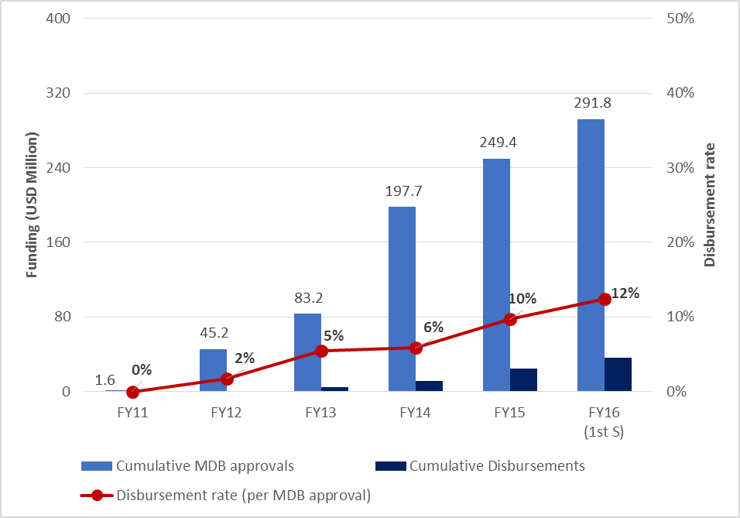
Disbursements
Actual disbursements continue upward trend
Disbursement rates remain low totaling USD 36.1 million, 12% of MDB approved funding
Pattern reflects relative immaturity of program and rates expected to pick up as portfolio moves through project cycle

Slide 11
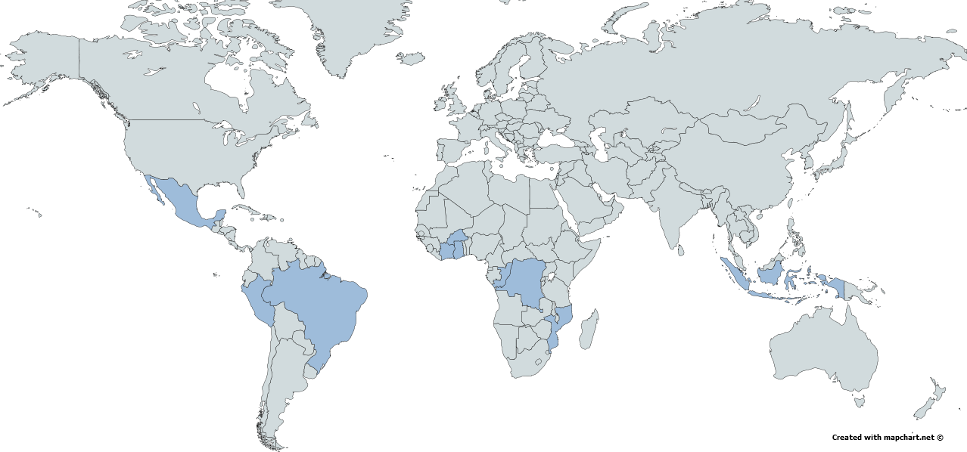
Dedicated Grant Mechanism
$80 million allocated for 14 FIP countries and a Global Learning and Knowledge Exchange Project
Brazil and Peru DGM launched
Global DGM effective June 2015, first Global Steering Committee held in Bali July 2015, outreach events at Paris COP

Slide 12
Gender and M&R in the FIP
Project performance on gender had improved
Review of three scorecard indicators
Sector-specific analysis 67% (cf. SCF average 85%)
Gender-disaggregated indicators 50% (cf. SCF average 71%)
Women-specific activities 67% (cf. SCF average 77%)
M&R scoring workshops planned for Ghana, Brazil
GHG methodologies workshop 2016
FIP M&R Toolkit revised to include gender-disaggregated results for all relevant indicators

