Slide 1
Engaging the Private Sector in Addressing Climate Change
- why, how, what….
Consultation
Washington, April 2008

Slide 2
Agenda
Transformation towards climate sensitive / climate resilient economies
Private Sector Financing
Examples: Using Concessional Finance to engage the Private Sector in the Climate Change Agenda
Conclusion

Slide 3


Transformation…
Transformation is the wide scale uptake of a – different - technology, process, or way of doing business in a country / sector / sub-sector

Slide 4
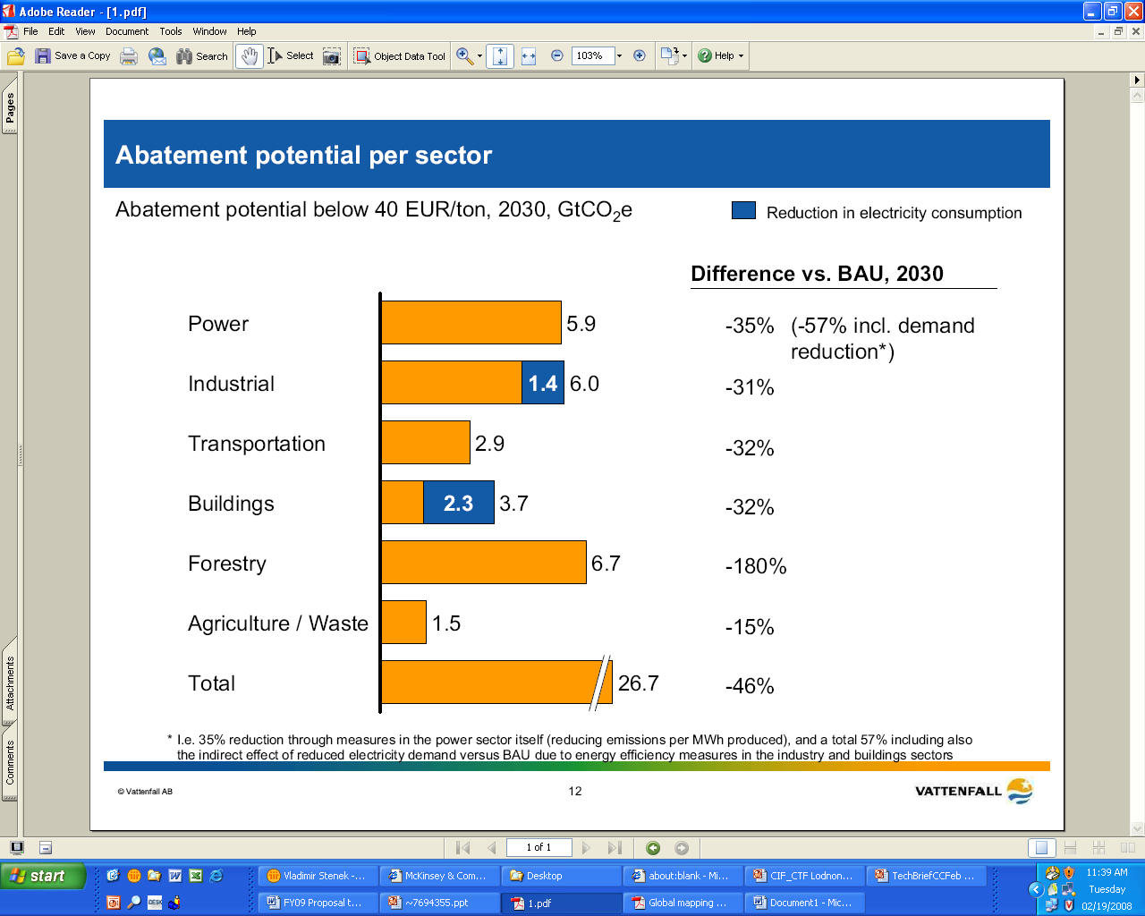
Transformational potential….
Source: McKinsey Global Institute (2008)

Slide 5
..comes at different cost…
High impact high cost: coal retrofit…
Source: McKinsey Global Institute (2007)

Slide 6
So – why is this not happening?
Market Barriers
Financial – additional cost or risk not – or only slowly - rewarded by markets (limitations of carbon finance); economies of scale need time; little venture capital
Behavioral (priorities, habits)
Regulatory (emission standards, energy subsidies, IPRs for new technology)
Perceptional (of high risk with new technologies, new providers, new processes..)
Technological (new technologies not yet available, slow to transfer)

Slide 7
Should at least energy efficiency investments not happen everywhere?
Companies have a choice
when investing…..
Expansion
Know how to do
Confidence in returns
$$$$
Cost Savings (EE)
Not done before
Uncertainty about
  actual savings
  (even after audit)
  Technology
  Business disruption..
…not ‘sexy’

Slide 8
Technology Transfer:
Should be everywhere?
“Mountain of Death”
  High costs of first commercial projects before economies of scale
Cost
“Valley of Death”
  No uptake by
  private sector
Role for
Concessional Funds
Proof of concept
First commercial projects
Economies of Scale

Slide 9
Engaging the private sector:
Different roles at different stages
Government programs
Regulation - selective subsidies– public enterprise
Public private partnerships/infrastructure
Fund(s)
Private Sector projects – with concessional finance
Demonstration projects
Risk mitigation (technological, financial, regulatory…)
Innovative financing schemes
Cost alleviation for first movers
Notes:
Private sector interventions most effective when real risks (technological, financial, environmental…..) are different than perceived risks – demonstration projects

Slide 10

Engaging the Private Sector in Financing
Climate Sensitive Investments
Focus on leverage points
Identification of Market Barriers
Interventions designed to (only) address barriers (risk, knowledge gaps, capacity gaps )
Smart phasing of interventions to ‘fit’ with work that addresses regulatory barriers

Slide 11
Agenda
Transformation towards climate sensitive / climate resilient economies
Private Sector Financing
Examples: Using Concessional Finance to engage the Private Sector in the Climate Change Agenda
Conclusion

Slide 12
Private Sector Investments:
A typical project cycle for an MDB…
Outline program objectives & parameters (internal)
Identify strategically relevant companies – existing & new clients
Present project concept to clients to elicit interest:
  Outline the benefits for the client
  Describe what support the MDB can offer (financing, TA, linkages, concessional funds)
  Set expectations: role of each party, timing, risks (within the project & for approval)
Due diligence, structuring, negotiation, legal documentation
Project implementation & disbursement of funds
Project supervision, monitoring & evaluation
Notes:
Note:
Strategically relevant: companies that can i) influence other companies – market leaders or ii) are committed & capable of project implementation
stage 3 takes a LOT of management time; a company will not move from 2 to 3 if the risk of approval is high, - the project dies here – no private sector uptake (or IOs won’t even offer it)
MDB internal approvals are between 3. & 4. above

Slide 13
Consultation with the Private Sector:
Where would concessional finance be useful?
Financial Institutions (consultation in February):
Cover risks market is not willing to bear (guarantees & other risk mitigants)
Regulations, legal & contractual laws essential
Aggregation of smaller projects – need to develop scale
Do not exclude energy efficiency – it’s not happening despite cost benefits
Use project finance tools to avoid market distortions – no end user subsidies; do not bail-out bad technologies
Power Sector Companies (consultation in March):
Replication of smaller projects
Leverage private investment
Focus on parts of large projects
Focus on the power sector value chain
Technology neutrality
Leave scope for identifying leap-frog / revolutionary technologies

Slide 14
Concessional Finance Instruments:
A tool to carefully allocate the “subsidy element”?
Concessional finance used to pilot energy efficiency risk-sharing tools:
Concessional Finance as
Risk Sharing/First Loss
Used to support FIs entering a new & untested market
Examples of good experience around the world (Eastern Europe, Asia)
Important to mitigate risk for in-country Banks / Financial Institutions (FI) and establish a track record for the underlying portfolio projects
Portfolio
MDB
50%
In-country Bank 50%
95%
Donors & Bank
5%

Slide 15
Credit enhancement can support clean energy investments
Credit Enhancement Facility
for a Wind Power Plant (or other RE facility)
Used to guarantee the cash flows from a distribution company to a wind plant (or other RE producer)
Important to give comfort to RE sponsors that future revenues will be secure (without this security, RE sponsors may hesitate to invest)
LTPPA
SPV
Electricity
DistCo
Off-takers
Funds ($)
Donor
Wind Plant
Credit Enhancement

Slide 16
Special financial structures can fill the equity gap for certain investment types
Concessional Finance as
subordinated debt for a $10 million RE project
Used to encourage the development of small scale renewable energy projects
Important to fill the equity gap for small scale RE projects
Financial structure relevant for individual projects and joint MDB / FI financing facilities
Equity
$2 million
Sponsor
Donor
Subordinate Debt
$1 million First Loss
Debt
$7 million
MDBs
Other private sector lenders

Slide 17
This is how it may work…
Financing Private Sector Projects through MDBs
Within the CTF’s overall context of eligibility & strategy:
MDBs propose (programs/projects) : strategy, approach, expected impact etc. – explain pipeline of likely large-scale projects and ‘envelope’ for small projects
Proposal approvals: based on fit of strategy and on series of investment criteria set out initially (e.g. transformational impact, development impact, financial leverage, additionality, financial sustainability).
Project approvals: Using MDB’s existing processes –all /most projects would involve MDB’s own resources. MDB Board approvals for larger projects, possibly approval of ‘envelopes’ for aggregating smaller projects.
Eligibility – instead of conditionality: e.g. countries – but not making allocations dependent on progress made by countries in regulatory framework

Slide 18
Agenda
Transformation towards climate sensitive / climate resilient economies
Private Sector Financing
Examples: Using Concessional Finance to engage the Private Sector in the Climate Change Agenda
Conclusion

Slide 19
What do private sector projects look like?
The following examples describe projects that:
Test new technologies
Apply existing technologies in new countries
Use financial institutions to achieve impact
Address efficiency in the power sector
Address efficiency in manufacturing sectors

Slide 20
Agenda
Transformation towards climate sensitive / climate resilient economies
Private Sector Financing
Examples: Using Concessional Finance to engage the Private Sector in the Climate Change Agenda
Conclusion

Slide 21
How to get it right….
Little margin for error – the first demonstration project must succeed for uptake - profitability critical (‘pick the winners’)
Large vs. small projects
Portfolio approach to address uncertainty
Clear limitations for concessional finance
Decision making fast, flexible, opportunistic, criteria driven
Investment principles key: profitability, financial sustainability, development impact (transformative, additional, leveraging, GHG impact, poverty alleviating)
Leverage existing agencies, processes, policies
Learning!

