Slide 1
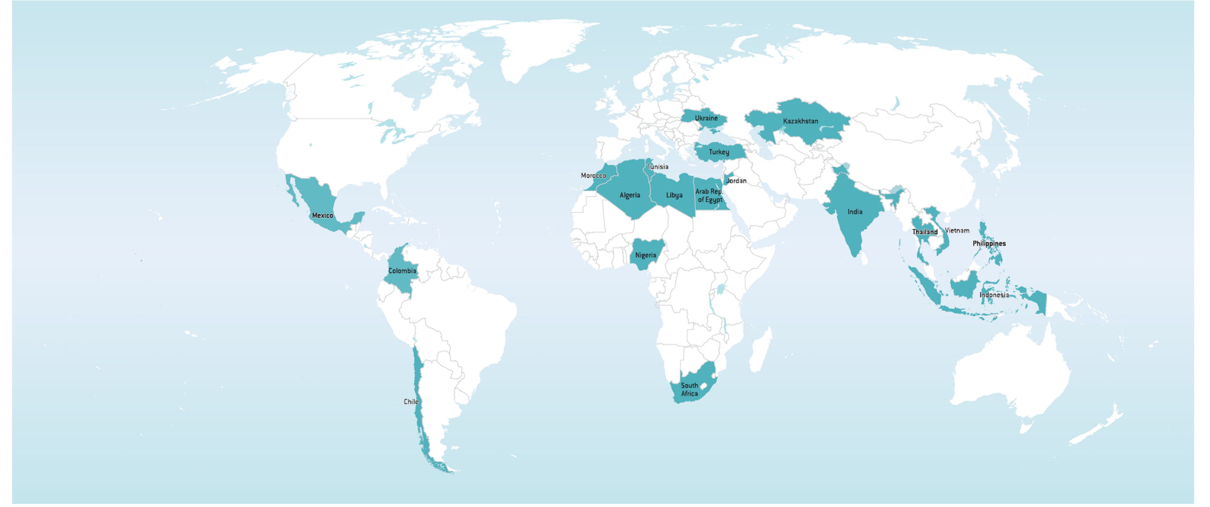
Clean Technology Fund (CTF)
Future Strategic Direction

Slide 2
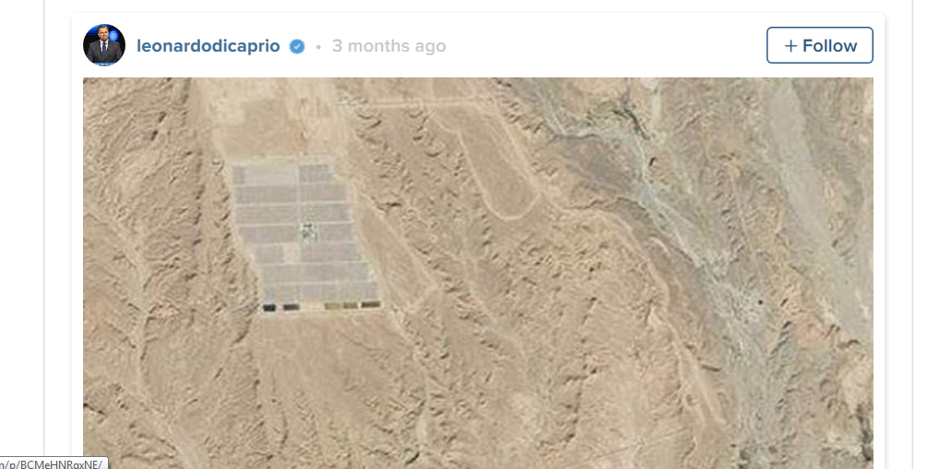

CTF on the ground..

Slide 3


Story So Far
2013
Dedicated Private Sector Program created
Private sector focus
Deliver at scale & speed Flexibility
2008
CTF goes live!
MDB partnership
Innovation & flexibility
Leveraging
2014
Contingent Recovery Grant - Geothermal
2010
1st CTF Disbursement Recorded
2013
MX Green Bond Securitization
2016
CTF Funds Fully Committed

Slide 4
Key features of the Business Model
MDBs as implementing agencies
Operational Scale
Toolkit of Instruments
Strong Governance & Flexible Business Model
AAA rated institutions with strong expertise in relevant climate-smart activities:
deal structuring
E&S
client engagement
Large CTF envelope ($6.1bn)
Substantial co-financing ($53bn)
Suite of
risk-appropriate tools:
equity
loans
mezzanine finance
guarantees
grants
local currency lending
advisory services
Flexible operational approach that can be adjusted according to the needs of both MDBs and the market
Notes:
Supplementary text:
CIF is important for MDBs as stringent MDB risk management practices prevent the MDBs from taking on certain high risk transactions that CIF resources are able to support. It is precisely these types of transactions that can have catalytic effects on markets.
The creation of large scale, viable commercially-oriented markets is an essential prerequisite to ensure transformation toward low carbon, climate resilient development
Wide array of financing instruments and advisory services helps MDBs overcome barriers inhibiting the development of viable markets such as lack of familiarity among investors with new technologies and the risks they present, lack of access to financing at needed terms (lower rate, longer tenor), and high upfront capital costs.
CTF’s robust governance structure, while falling outside of the UN/UNFCCC framework, allows for operational agility to meet market needs while protecting the interests of stakeholders

Slide 5
Numbers
Funding
Disbursement Trend
Results
 | Actual (RY15) | Target | %
GHG reductions (mtCO2e/yr) | 5.5 | 44.6 | 12%
Co-financing ($m) | 4,028 | 33,536 | 12%
Installed capacity (MW) | 1,057 | 15,039 | 7%
Additional passengers (m-PPD) | - | 6 | 0%
Energy savings (GWh/yr) | 3,952 | 8,861 | 45%
*55 projects, or $3.5bn in MDB approved projects at various stages of implementation.

Slide 6

Value proposition: CTF 2.0
Opportunity
Barriers
CTF 2.0
Emerging markets require an estimated $3 - 4 trillion annually in low-carbon investments over the next
15 years
MDBs uniquely positioned to help plug the gap with a broad range of offerings both in terms of sectors and instruments
MDB climate finance is expected to double by 2020 to $36 billion a year, with explicit demand for more concessional finance to help meet this goal
Country-level
Scarce public resources with competing priorities
Weak regulatory framework
Lack of access to long-term, predictable, affordable finance
Technology / commercial risks
Project-level
High upfront costs
Low / no-revenue generation
Long time frames
High transaction costs
Lack of capacity
Lack of market knowledge
Limited access to capital markets, and narrow investor base
Enhanced Programmatic Approach
Building on experience e.g. country-programs, DPSP
Priority Investment Areas
Incl. energy storage,
Sustainable transport,
Energy efficiency in buildings,
Distributed generation
New Financing Modalities
Green Markets
Risk Mitigation Facility
Notes:
Supplementary text:
It is estimated that in the next 15 years, the world will need to invest around $90 trillion in sustainable infrastructure assets (cities, transport systems, energy systems, water and sanitation, and telecommunications) As much as 2/3 of this investment (est. $3-4 trillion per year) will be concentrated in low- and middle-income countries.
As the CTF business model that has been proven to unlock climate finance at scale and leverage tens of billions in additional finance, we are now investigating how the new CTF will operate in order to have an even larger impact when it is needed most
The new CTF should build on past experiences to capture new opportunities. The key elements of this new proposed CTF entail:
Moving from a reliance on public donor funds (and competing with funds for European refugee crisis, Zika, Ebola, IDA, etc) towards financially sustainable operations through tapping into capital markets
Maintaining core aspects of the CTF business model while allowing for a flexible operational approach
We are calling this new model CTF 2.0. This model will be based on the establishment of a capital markets-based vehicle (CTF Green Markets) that will issue asset-backed securities on the international capital markets to finance a new generation of CTF projects.

Slide 7

Potential investment priorities
Energy Storage
Opportunity • Manage intermittent and distributed nature of renewable energy • Improve grid efficiency • Cost effective alternative to aging transmission and distribution networks
Barriers • Cost of technology and payback time • Lack of regulatory clarity • Uncertain revenue streams • Access to commercial finance
Role of concessionality Facilitate scaling-up through interventions that help bridge gap to commercial project viability, mitigate risks, finance first-of-its-kind projects and support technical assistance work

Slide 8

Potential investment priorities
Distributed generation
Opportunity • Global capacity additions to surpass new centralized additions in 2018 • Over 80 GW of annual installed capacity in emerging markets (2014-23) • Global distributed solar PV annual capacity additions to grow from 20 GW (2015) to over 30 GW (2020), $70 billion eq. market
Barriers • Regulatory risks, due to lack of experience • Higher cost, compared to alternative fossil fuel choices • Lack of access to long-term financing • Complex stakeholder interests
Role of concessionality • Lending for longer tenors than MDBs to improve project economics over fossil fuel based generation • Subordinated loans to demonstrate commercial viability • Early stage equity

Slide 9
Potential investment priorities
Sustainable Transport
Opportunity • Transport accounts for 23% of global CO2 emissions addressing which would also result in co-benefits like reduced congestion, pollution and accidents, improved health, quality of life, enhanced productivity and economic growth
Barriers • Revenue generating ability is often limited by affordability concerns; even operational cost recovery is a challenge, making it difficult to attract private sector funds at scale.
CTF’s role • MDB-collective model critical to managing complex governance and risks involving environmental, social, inter-governmental, and public-private issues • Programmatic approach optimal for the types of transformative, systemic investments that will be required, whether with sub-national interventions or for private sector-led initiatives

Slide 10

Potential investment priorities
Energy Efficiency in Buildings
Opportunity • Account for about one-third of global energy use and related GHG emissions; with short payback periods, $1 invested in energy efficiency measures can potentially generate $3 in future fuel savings by 2050
Barriers • Higher costs • Lack of a market entity to absorb these costs • Lack of a system to validate savings; that hinders flow of capital to the sector • Lack of market information
CTF’s role • Absorb incremental ‘greening’ cost, or provide performance assurances through innovative financial structures, or certification processes

Slide 11



CTF Green Markets
Concept
Move CTF to a self sustaining path through issuing investment grade, asset-backed securities in capital markets, drawing full value from the pool of diversified MDB-originated legacy CTF assets to back the new securities
Features
Keep fundamentals such as MDB-collective model, range of instruments offered currently (e.g. loans, equity, guarantees etc.) while supporting a wide range of sectors/ technologies, and attracting a broad investor base through a large diversified pool of green technology investments
Achievable leverage
Potentially raise USD 4.25 billion (i.e. through a $500 - $750 million issuance every nine months), or USD 1.5 billion in the absence of a contingent financing facility
Notes:
Concept • Raise funding through periodic issuances of bonds in the international capital markets using legacy CTF reflows for credit enhancement purposes moving CTF on a self-sustaining path
Achievable leverage • Potentially raise USD 4.25 billion through first cycle of bond issuances (i.e. through a $500 - $750 million issuance every nine months), or USD 1.5 billion through its first cycle of issuances in the absence of a contingent financing facility
Features • Draw full value from the pool of diversified MDB-originated legacy CTF assets to back the new securities • Keep fundamentals such as MDB-collective model, range of instruments offered currently (e.g. loans, equity, guarantee etc.) • Wider range of sectors supported
Limitations • Concessionality currently offered might be curtailed
• A contingent facility will further increase the volume of bonds issued and as a result, projects supported

Slide 12
Risk Mitigation Facility
Concept
Scale up mobilization of local and international private capital for clean technology projects through provision of risk mitigation guarantees (e.g. partial credit guarantee, first loss, second loss, contingent finance) by utilizing expected legacy CTF reflows
Features
RMF guarantees (e.g. partial credit guarantee, first loss, second loss, contingent finance) would be issued on a non-accelerable basis
Established and operated by IBRD on behalf of the CTF; flexibly designed to include other participating CTF-MDBs to offer the products through an Umbrella Agreement
Achievable leverage
Initially USD 1 billion through ring fencing USD 1.25 billion of legacy CTF reflows , with further expansion potentially funded through CTF Green Markets, on a standalone basis, by increasing the amount of ring-fenced legacy CTF reflows
Notes:
Concept • Raise funding through periodic issuances of bonds in the international capital markets using legacy CTF reflows for credit enhancement purposes moving CTF on a self-sustaining path
Achievable leverage • Potentially raise USD 4.25 billion through first cycle of bond issuances (i.e. through a $500 - $750 million issuance every nine months), or USD 1.5 billion through its first cycle of issuances in the absence of a contingent financing facility
Features • Draw full value from the pool of diversified MDB-originated legacy CTF assets to back the new securities • Keep fundamentals such as MDB-collective model, range of instruments offered currently (e.g. loans, equity, guarantee etc.) • Wider range of sectors supported
Limitations • Concessionality currently offered might be curtailed
• A contingent facility will further increase the volume of bonds issued and as a result, projects supported

Slide 13

Next steps
The CIF Administrative Unit, in consultation with the MDBs and Trustee to:
Adopt an enhanced programmatic approach • Explore and propose any modifications required in current CTF documents for implementation;
Focus on priority investment areas • Develop concrete proposals that could be implemented within 18-24 months;
Develop new financing modalities • Conduct any necessary due diligence to fully develop proposals;
Identify legal implications • Explore any necessary modifications in CTF documents such as legal agreements and initiate any other necessary consultations with relevant parties;
Address Contributors’ interests • Conduct any necessary consultations on making available the reflows (and any other available assets in the CTF trust fund) for use in accordance with a decision by the Committee • Agree with the contributors on the required arrangements as soon as feasible.

Slide 14
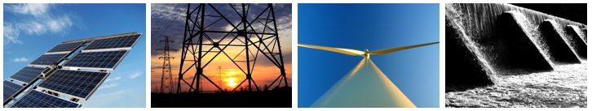




Thank You!
Mafalda Duarte
Mduarte@worldbank.org
(202) 473 - 4678
www.climateinvestmentfunds.org
@CIF_Action
https://www.youtube.com/user/CIFaction
https://www.flickr.com/photos/cifaction/sets

Slide 15





Strategic highlights
  3X increase in climate financing to US$5 billion annually by 2020
  >2X increase in climate financing
  Up to US$6 billion by 2020
  (US$4 billion/ mitigation, US$2 billion/ adaptation)
  Increase share of environment/climate financing from 25 to 40 % of annual commitments by 2020, reaching US$20 billion over the next 5 years
  Increase from 14 % of annual commitments to 25-30 % by 2020
  Total financing: $29 billion per year by 2020
  Mobilize $25 billion of funds for clean energy over FY16–20 (est. demand of non-IDA concessional finance of $3-5 billion until 2020 in Energy sector only)
  FOCUS:
  (i) Renewable energy and energy efficiency
  (ii) Sustainable mobility
  (iii) Resilient, competitive low-carbon cities;
  (iv) Climate-smart land use and food security;
  (v) Green competitiveness; (vi) Leaving no one behind

