Slide 1
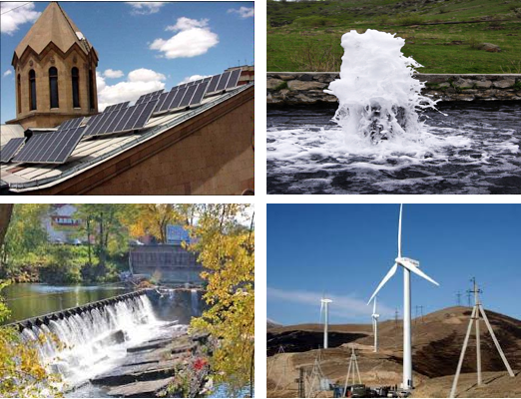
Republic of Armenia
Scaling Up Renewable Energy Program (SREP)
Investment Plan
June 2014

Slide 2
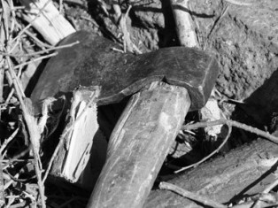
Energy Crisis in Armenia
1991-1996

Slide 3
In the last decade, the energy sector has overcome many challenges
Future challenges focus on medium- to long-term supply adequacy and security
 | 1999 | 2014
Electricity system losses (% of net generation) | 30% | 14.6%
Collection rates | 88% | 100%
Quasi-fiscal deficit | 10% of budget | As a sector, one of the largest taxpayers in Armenia
Reduced reliance on gas for electricity generation | 45% thermal | 30% thermal
Safe gas-based heating | < 10% | >60%
Gasification | < 80,000 residential subscribers | > 600,000 residential subscribers

Slide 4
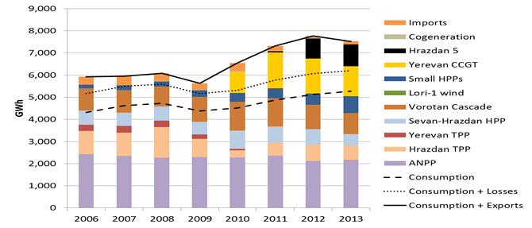
Description of the power sector
Generation (2013)
Available Capacity – Summer (MW) | 2600 (Higher summer capacity is due to larger availability of hydro)
Available Capacity – Winter (MW) | 1900
Consumption (2013)
Total Consumption (GWh) | 5267
Summer Peak Demand (MW) | 960
Winter Peak Demand (MW) | 1520
The power sector is fully unbundled
Most of the large generation plants, distribution company and all of the small RE are
privately owned
The sector is regulated by independent and competent regulator
The Ministry of Energy and Natural Resources develops and implements energy policy

Slide 5
Renewable energy is essential for ensuring adequate level of energy security
70% of electricity generation dependent on imported fuels.
2. 30% is generated by two large hydropower cascades, 150 small hydropower plants, and other small renewable energy power plants.
Threats:
(i) gas supplies are interrupted,
(ii) nuclear plan is shut down for unplanned safety reasons;
(iii) drought constraints utilization of hydro plants.
100% of the natural gas required for all sectors of the economy is imported.
4. 100% of the petroleum and other transport fuels is imported.

Slide 6
Government Prioritization of Renewable Energy
:
The Law on Energy (2001)
The Law on Energy Saving and Renewable Energy (2004)
Energy Sector Development Strategy (2005)
Action Plan of the Ministry of Energy and Natural Resources (2007)
National Program on Energy Saving and Renewable Energy (2007)
Hydropower Development Strategy (2011)
National Energy Security Concept (2013)
Amendment to the Law on Energy (2014) establishing mandatory off-take period of 20 years for small renewable plants

Slide 7
Regulatory framework for RE is being continuously improved
Competent and independent energy regulator
Tariffs at cost-recovery levels with sound tariff setting methodology
Feed-in tariffs for small hydro, wind, biomass and biogas
No license for solar PV <150 kW capacity, net metering operation
Off-take guarantee of 15 years for small RE that was extended to 20 years
Solvent privately owned distribution company
Escrow account arrangement ensuring that all generators get paid in full and without delay
3-year VAT payment deferral for importers of plant and equipment with total value of more than $0.5 million, no custom fee

Slide 8
Government is committed to increase penetration of RE to specified targets
The Government remains committed to RE targets assumed under EU directives:
21% by 2020 and 26% by 2025
Share of RE in the mix today is 9%*
 | Capacity installed (MW) |  | Generation (GWh)
Electricity | 2020 | 2025 | 2020 | 2025
Small Hydro | 377 | 397 | 1,049 | 1,106
Wind | 50 | 100 | 117 | 232
Geothermal | 50 | 100 | 373 | 745
Utility-scale PV | 40 | 80 | 88 | 176
Total | 492 | 677 | 1,627 | 2,259
Heating | 2020 | 2025 | 2020 | 2025
Geothermal heat pumps | 12 | 25 | 16 | 33
Solar thermal | 10 | 20 | 13 | 25
*Does not include large hydro

Slide 9
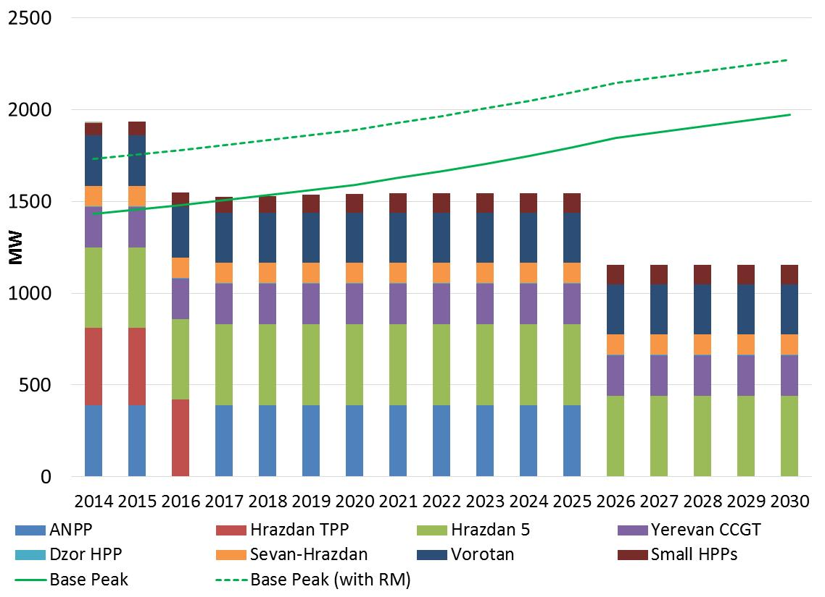
Identified priority RE technologies will help reduce impending supply capacity gap and increase energy security
Identified priority RE will help reduce 400 MW of capacity gap
40-50 MW of solar PV will help save water at HPPs that can be used to generate power during evening peaks
At least 28 MW geothermal plant will be base load and available to meet peaks
Geothermal heat pumps and solar water heaters will save fuel/water that can be used to generate power to meet peaks
All of the identified priority RE will help reduce dependence on gas imports, thus, improving energy security

Slide 10
Identified priority RE technologies will have benefits beyond energy sector
1. Economic development
Job creation (temporary jobs during construction and permanent jobs for operation of RE projects and in respective industries)
Bolstering of certain industrial sectors (e.g. supply and installation of solar PV, geothermal heat pumps and solar heaters)
Environmental
Reduction of greenhouse gas and other particle emissions
Gender
Targeted job creation for women. Operational agreements for the renewable energy projects will be structured in a way to encourage jobs for women

Slide 11
Identified priority RE projects have high degree of implementation readiness
Exploratory drilling at Karkar:
All critical geo-technical studies to assess the site were completed
Determination of locations of test wells is underway (supported by World Bank/ESMAP)
Exploratory drilling program, including bidding documents for drilling are ready
Experienced implementing entity (R2E2 Fund) has solid capacity and can start project preparation immediately
Utility-scale Solar PV:
Sites with highest solar irradiation are known (ADB survey) and detailed site-specific measurements can start immediately
R2E2 Fund can start preparation immediately
Geothermal Heat Pumps and Solar Thermal:
Ongoing Caucasus Energy Efficiency Program (CEEP) of EBRD can be expanded with potential SREP funds to promote development of heat pumps and solar thermal until E5P funds become available in 2016

Slide 12
The Government can successfully implement SREP funded projects because…
Necessary legal, regulatory and institutional framework is ready
The Government has a competent team in the Ministry of Energy and Natural Resources as well as capable implementing entity – the R2E2 Fund
Private sector is interested to invest in renewable energy sector
The scientific community and academia remain committed and interested in geothermal and solar technologies
Strong ecological society requires the scale up of sustainable energy
The Government has successfully implemented several donor-funded projects in the renewable energy sector, including the WB, EBRD, KfW.
Disbursement ratio of the World Bank projects in Armenia is the 2nd highest in Europe and Central Asia Region

Slide 13
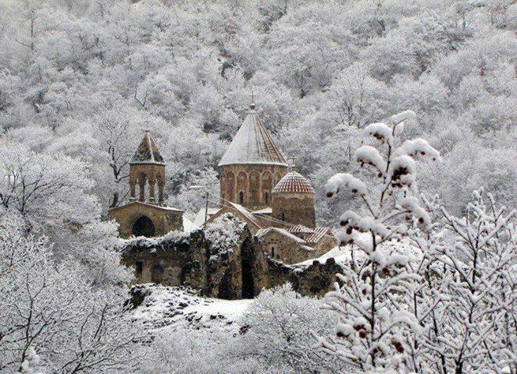
The SREP support will help us to have a success story for scaling up identified RE technologies and making Armenia more energy secure
THANK YOU

Slide 14
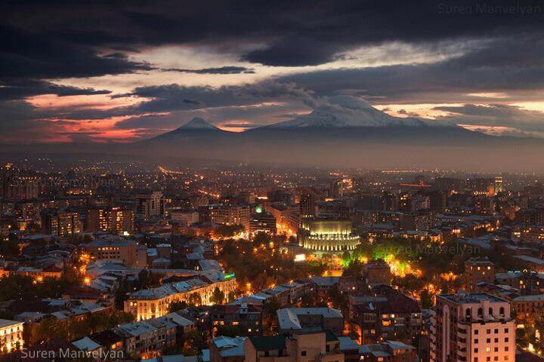
The SREP support will help us to have a success story for scaling up identified RE technologies and making Armenia more energy secure
THANK YOU

